Slide 1
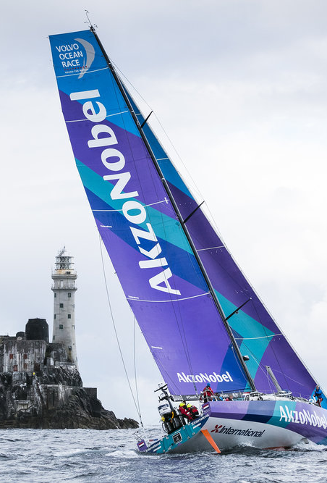

PAINT DRUM TESTING
industrial client: AKZO Nobel
By
Group 5
Bala Vignesh Subramanian- Project Manager
Prasad Pandeti – Communication Lead
Akanle Olusola Matthew – Project Team Member
Anand Kumar Kolakaluri- Project Team Member
Guided by
Academic Supervisor
Dr. Yolanda Sanchez Vicente.

Slide 2

OBJECTIVES
Easy loading and unloading
Hydrodynamic & Buoyance properties
Design improvement & recommendations
Modelling and simulation
Creating prototype

Slide 3

KEY MILESTONES:
Key objectives | Delivered
Corrosion of Nuts and Bolts | New Design
Reducing number of fittings | Thread Locking System
Buoyance &Hydrodynamic Properties | Increase in Weight
Finalising the material | Good buoyance properties
Marine Bio-fouling | Remedies for Bio-fouling
Analysis | Simulation for Thread Locking design

Slide 4
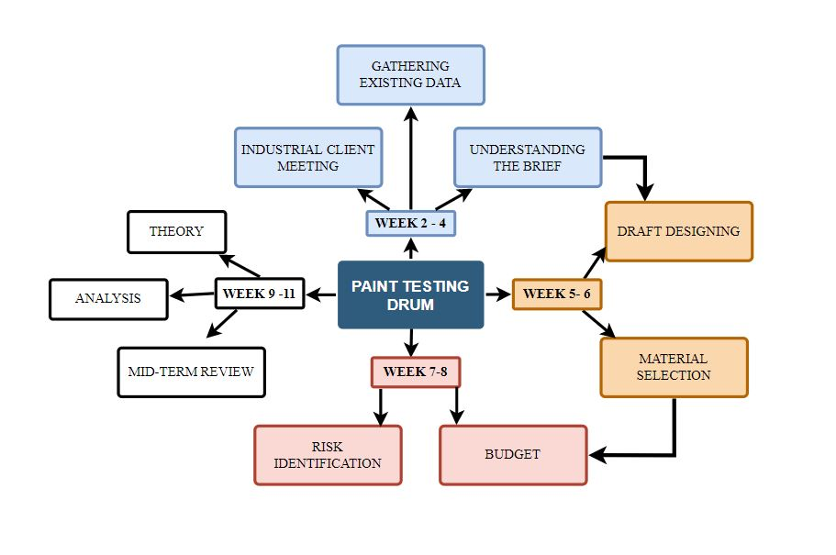
CRITICAL PATH
Identifying the issues based on the Probability of risk
Key tasks are performed and delivered in mentioned time.

Slide 5
RISK IDENTIFICATION
RISK IDENTIFICATION | RISK MITIGATION
Unknown of Buoyance properties of existing design | Calculating Buoyance using the dimensions of the clients drawing
Buoyance issues in the acrylic | Mitigating buoyance issues by reducing the hollow space inside the drum
3D Printing for Acrylic material
Max Temp of Acrylic material is 80 C | Keeping the print between 50 to 80 C
Locking issues in New design | Implementing Allen key type locking

Slide 6

DESIGN

Slide 7
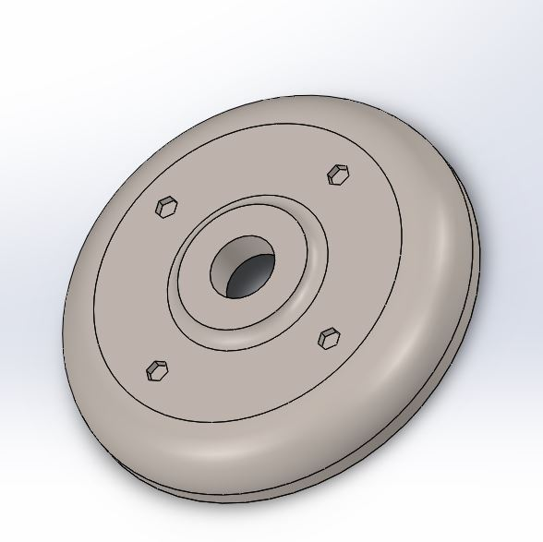
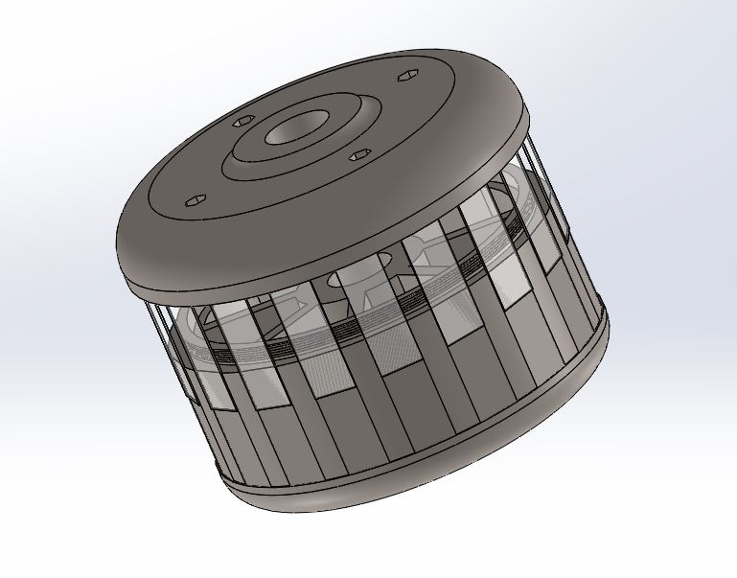
3-D VIEW OF THREAD LOCKING SYSTEM:
Picture1: Top Part
Picture 2: Bottom Part

Slide 8
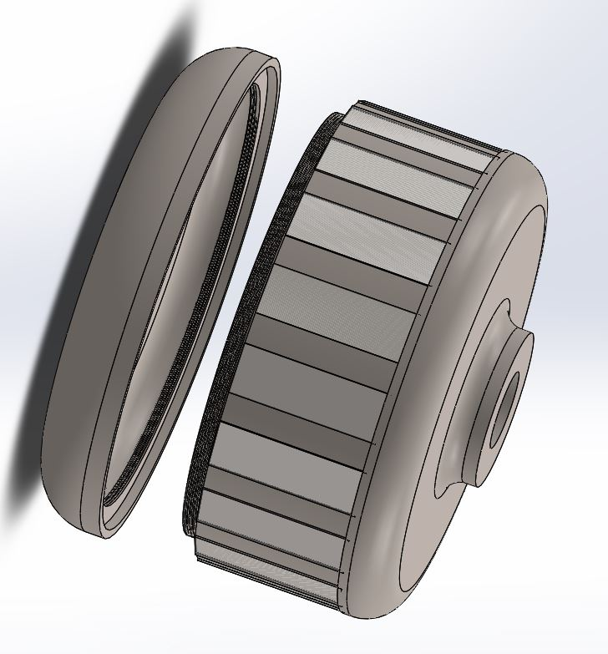
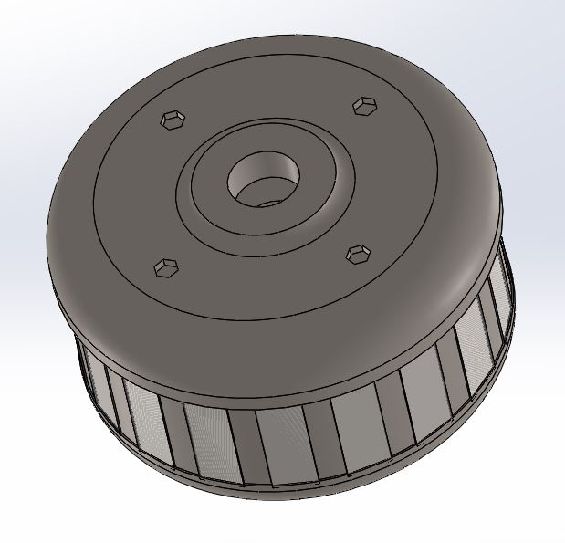
ASSEMBLY VIEW
Picture 3: Assembly View
Picture 4: Assembly View2

Slide 9

SIMULATION

Slide 10
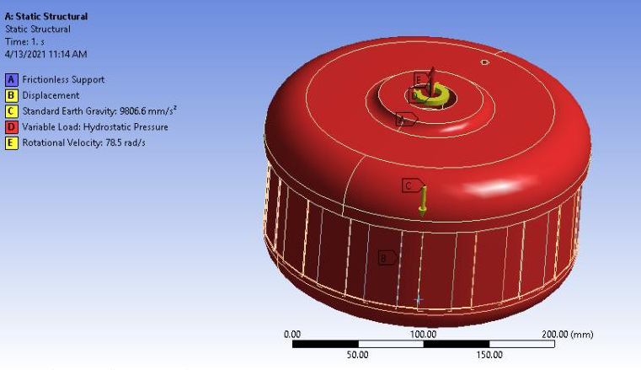
STRUCTURAL ANALYSIS
Input:
Rotational Speed – 750rpm
Immersed Depth – 1m Young’s Modulus – 2.5 e^9 Pa Yield Strength – 2.86 e^7 Pa
Tensile Strength – 6 e^7 Pa
Temperature – 22 Degree Gravity – 9.8 m/sec2

Slide 11
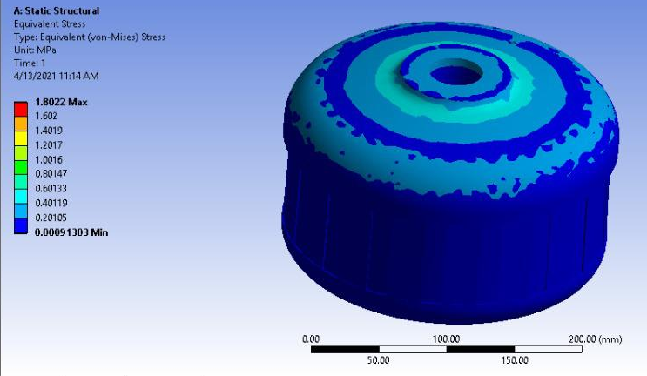
STRESS CALCULATION
Result:
Max Stress – 1.802 Mpa
Min Stress – 0.0009 Mpa

Slide 12
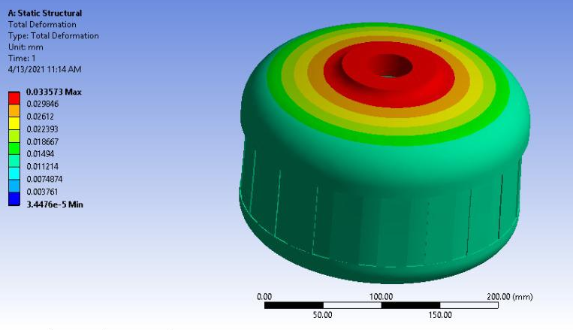
STRAIN DIAGRAM
Result:
Max Strain – 0.033 Mpa
Min Strain– 3.447 e-6 Mpa

Slide 13

CALCULATIONS

Slide 14
BUOYANCY CALCULATIONS
Mass = 5.55 kg, Volume = 4.6x e^06 mm3, Density = 1025 kg/m3 (sea water)
Gravity = 9.81 m/sec2
Flow speed of the water = 1500 m/sec (Apx)
Dynamic Viscosity = 25degree Celsius (0.0089 kg/m2sec)
Formula,
F_{b} = V_{s} × D × g, F_{b} - buoyancy force, V_{s} - submerged volume, D – density, g – gravity.
F_{b} = 46.45 N
Weight = mass x g W= 54.38N
Weight > Buoyancy Force, Drum will submerged into the water

Slide 15
HYDRODYNAMIC CALCULATIONS:
Reynolds Number Calculation
Rn=(ρVL)/μ
Ρ = 1200kg/m3 V = 1500 m/sec L = 0.96 m μ = 8.90 x 10^-4 kg/msec2
Rn = 1.942 x 10 ^9
Rn > 4000, so the flow is Turbulent ( Sea water flow will be turbulent)
F = m x a = 5545.65 kg x 9.81
= 54.446 N
Torque, T = F x r x sin(ᴓ)
= 5.187 Nm

Slide 16

RESULT
For the new design we have achieved
Object will submerged into the fluid with F_{b} = 46.45N
Displaced fluid 4.737 Kg
Testing Strips – 18
Sea water flow will be turbulent

Slide 17

EXISTING PROBLEMS & RECOMMENDATIONS

Slide 18
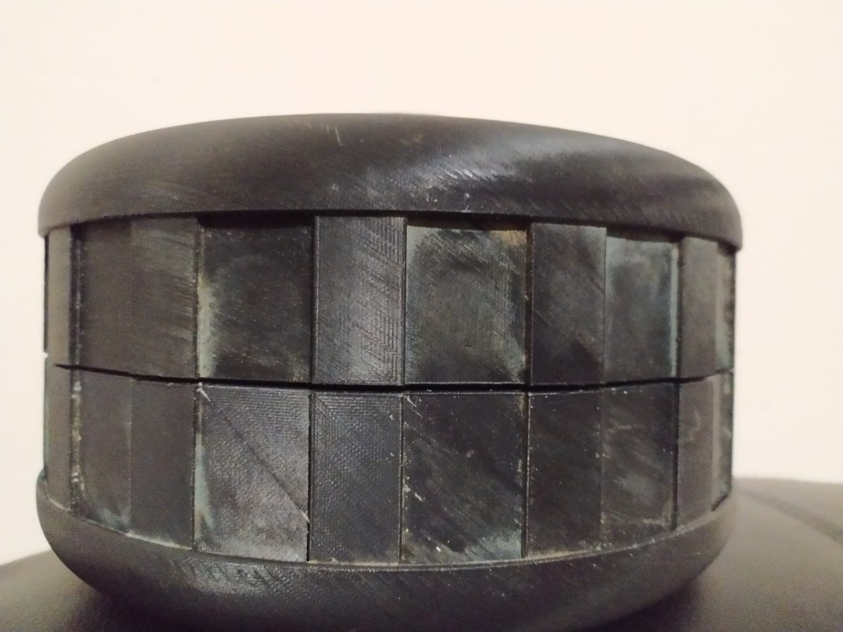
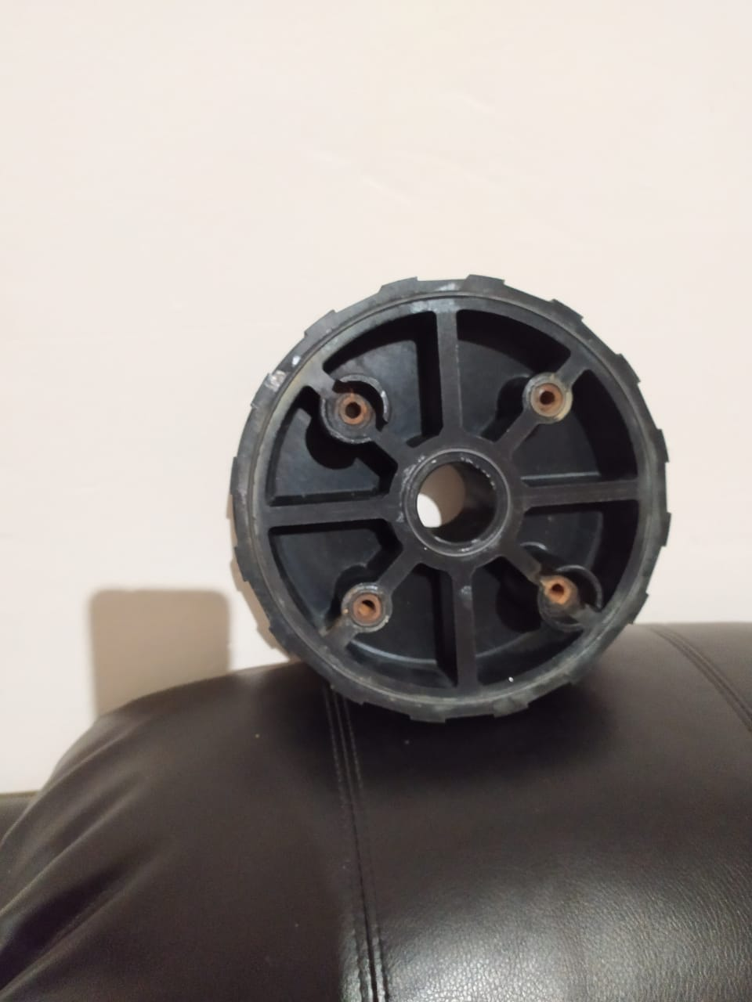
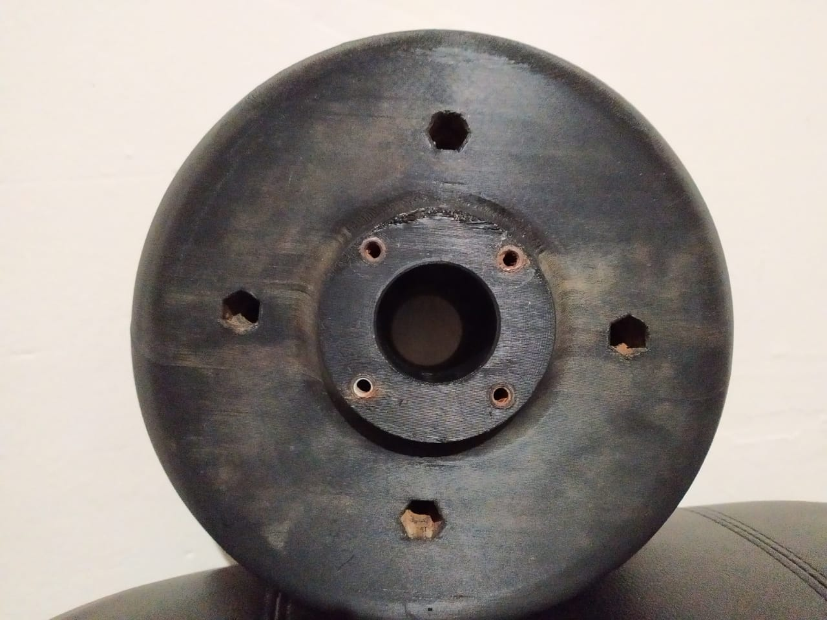
PROBLEMS
Assembly View
Inner View
Corrosion of
Nuts and Bolts
Gap between
Top and Bottom Part
Outer View Weight Increases

Slide 19
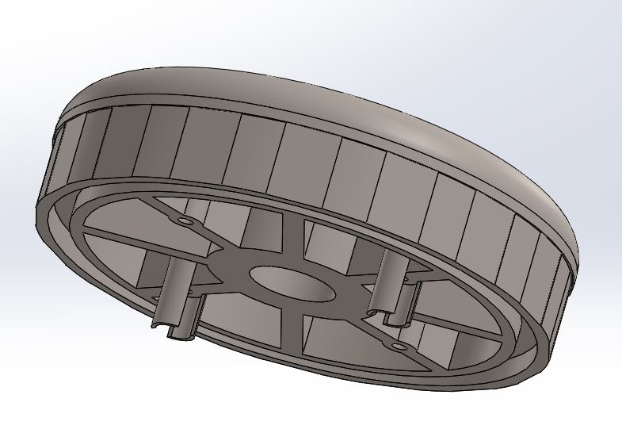
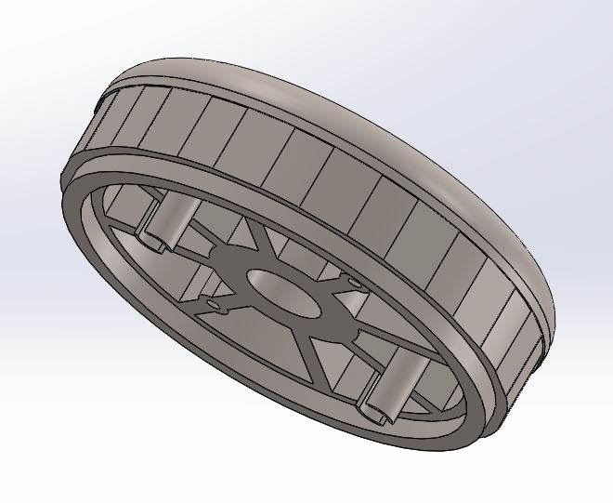
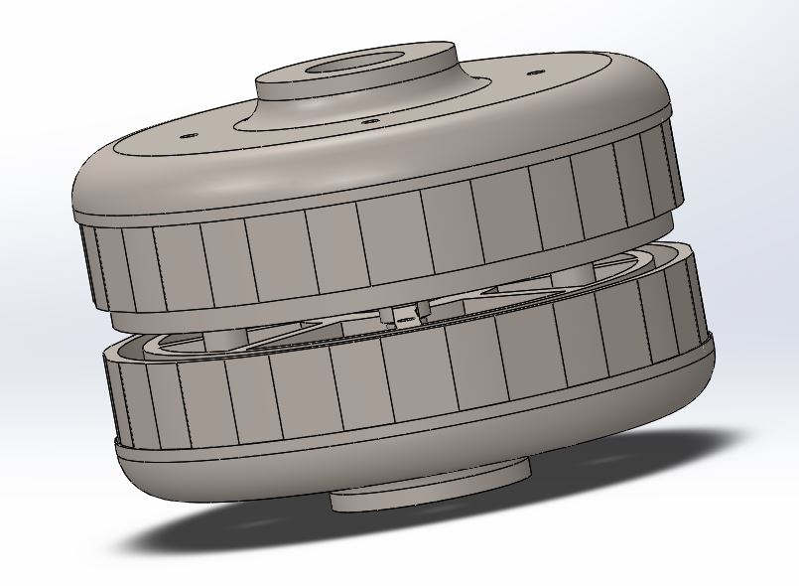
SUGGESTING SOLUTION
Extrude cut in the Top Part
Extension in the Bottom Part
Assembling view

Slide 20
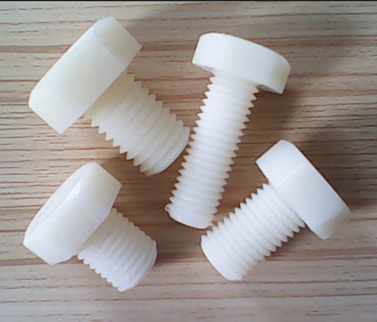
PLASTIC NUTS AND BOLTS
Nylon 6.6 (Polyamide 6.6) Hex Head Fully Threaded Set Screws/Bolts
Plastic Hex Head Bolts and Screws are the ideal fasteners for mechanically securing materials
lightweight and resistant to corrosion, oil, abrasion and most chemicals
Plastic Nuts and Bolts

Slide 21
CALCULATIONS
Mass = 4.62x e^03 g
Volume = 3.85x e^06 mm3
Density = 1025 kg/m3 (sea water)
Gravity = 9.81 m/sec2
Formula,
F_{b} = V_{s} × D × g, F_{b} - buoyancy force, V_{s} - submerged volume, D – density, g – gravity.
F_{b} = 38.7N
Weight = mass x g W= 45.32N
Weight > Buoyancy force, Drum will submerged into the water

Slide 22
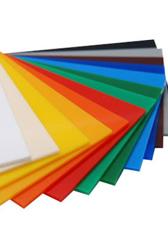
MATERIAL PROPERTIES
Chemical properties:
Effects of acids: Acrylic fibres are resistant to acids
Effect of Alkalis: Crystalline nature prevents the entre of the alkaline
Applications:
Transparency and high break Resistance
Easy to fabricate
Max Temp of Acrylic material is 80 C

Slide 23
APPLICATION
BUOYANCY PROPERTIES
Properties | Existing Design | New Design
Weight | 34.138N | 54.234N
Volume | 2.9 x e^6 mm3 | 4.6x e^06 mm3
Buoyancy | 29.15 N | 46.45 N
Displacement of Fluid | 2.97 kg | 4.737 Kg
HYDRODYNAMIC PROPERTIES
Flow : Turbulent
Torque generated : 5.187 Nm

Slide 24

BIO FOULING

Slide 25
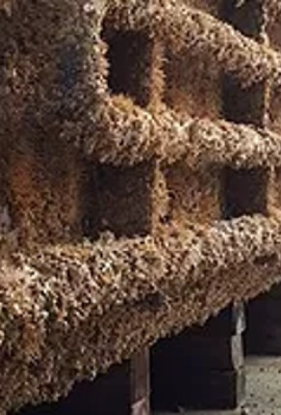
BIOFOULING
Reasons :
Expose of Micro organisms
Control of Biofouling:
Coatings using biocides, thermal treatments, or pulses of energy.
Thin Film in the ship Hull.
In industrial processes, bio-dispersants are used to control underwater hull corrosion.

Slide 26
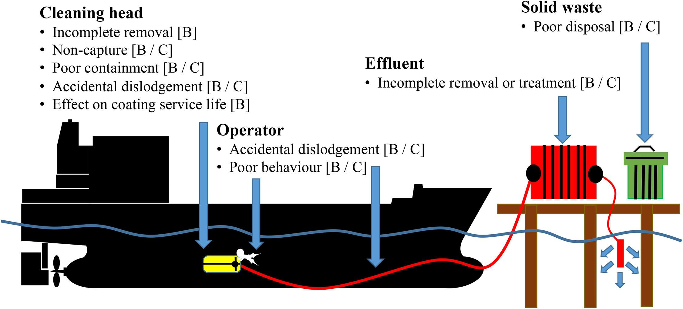

Slide 27
CONCLUSION
Objectives achieved:
New Thread locking system
Higher Buoyance than existing design
Testing space increased
Recommendations:
Further analysis on underwater testing – keeping drum below 15m
Increase in Hollow space inside the drum
Increasing motor HP

Slide 28

Thank you !

Slide 29

Questions?

